Slide 1
Chapter 6
RISK ANALYSIS AND MANAGEMENT

Slide 2
SOFTWARE RISKS
Risk always involves two characteristics:-
• Uncertainty—the risk may or may not happen; that is, there are no 100% probable risks.
• Loss—if the risk becomes a reality, unwanted consequences or losses will occur.
When risks are analyzed, it is important to quantify the level of uncertainty and the degree of loss associated with each risk. To accomplish this, different categories of risks are considered.
1.Project risks
Project risks threaten the project plan. That is, if project risks become real, it is likely that project schedule will slip and that costs will increase. Project risks identify potential budget, schedule, personnel (staffing and organization), resource, customer, and requirements problems and their impact on a software project. Project complexity, size, and the degree of structural uncertainty were also defined as project (and estimation) risk factors.
2. Technical risks
Technical risks threaten the quality and timeliness of the software to be produced. If a technical risk becomes a reality, implementation may become difficult or impossible. Technical risks identify potential design, implementation, interface, verification, and maintenance problems. Technical risks occur because the problem is harder to solve.

Slide 3
3. Business risks
Business risks threaten the viability of the software to be built. Candidates for the top five business risks are:-
market risk
strategic risk
building a product that the sales force doesn't understand how to sell
management risk
budget risks
4. Known risks
5.Predictable risks
6.Unpredictable risks

Slide 4
RISK IDENTIFICATION
Risk identification is a systematic attempt to specify threats to the project plan (estimates, schedule, resource loading, etc.). By identifying known and predictable risks, the project manager takes a first step toward avoiding them when possible and controlling them when necessary.
There are two distinct types of risks 1. generic risks and 2.product-specific risks.
Generic risks are a potential threat to every software project.
Product-specific risks can be identified only by those that has a clear understanding of the technology, the people, and the environment that is specific to the project at hand.

Slide 5
One method for identifying risks is to create a risk item checklist. The checklist can be used for risk identification and focuses on some subset of known and predictable risks in the following generic subcategories:
• Product size—risks associated with the overall size of the software to be built or modified.
• Business impact—risks associated with constraints imposed by management or the marketplace.
• Customer characteristics—risks associated with the sophistication of the customer and the developer's ability to communicate with the customer in a timely manner.
• Process definition—risks associated with the degree to which the software process has been defined and is followed by the development organization.
• Development environment—risks associated with the availability and quality of the tools to be used to build the product.
• Technology to be built—risks associated with the complexity of the system to be built and the "newness" of the technology that is packaged by the system.
• Staff size and experience—risks associated with the overall technical and project experience of the software engineers who will do the work

Slide 6
Assessing Overall Project Risk
the overall risk of a software project can be evaluated by answering some key questions. These questions are based on feedback from experienced project managers worldwide. They help determine how likely the project is to succeed.
Here’s a simplified explanation of the questions:
Support from Managers: Have the top people (both software and customer managers) officially agreed to back this project?
Commitment from Users: Are the people who will use the software excited and fully supportive of the project?
Understanding Requirements: Does the software team understand exactly what the users and customers need?
Customer Involvement: Have the customers played an active role in defining what they want?
Realistic Expectations: Do users have practical and achievable expectations for what the software can do?
Stable Scope: Is the project's purpose and scope clear and unlikely to change?
Team Skills: Does the software team have all the necessary skills to complete the project?
Stable Requirements: Are the project requirements clear and unlikely to change much?
Familiar Technology: Does the team have experience with the technology they’ll use for this project?
Enough People: Is the team size sufficient to handle all the work?
Agreement on Goals: Do all users and customers agree on why the project is important and what it should achieve?

Slide 7
If you answer "no" to any of these questions, it means there’s a risk to the project in that area. To reduce the risk, you need to:
Mitigate: Take action to fix or improve the situation.
Monitor: Keep a close eye on that issue.
Manage: Plan steps to handle any problems that might arise.
Risk Components and Drivers
The U.S. Air Force has written a pamphlet that contains excellent guidelines for software risk identification . The Air Force approach requires that the project manager identify the risk drivers that affect the
software risk components—
Performance risk :- This is about whether the software will meet all its requirements and serve its purpose properly.
Cost risk :- This looks at how likely it is that the costs won’t exceed what was planned.
Support risk :- This is about how maintainable and adaptable the software will be after it’s delivered.
Schedule Risk :- This measures the uncertainty of whether deadlines will be met and the product will be delivered when promised.

Slide 8
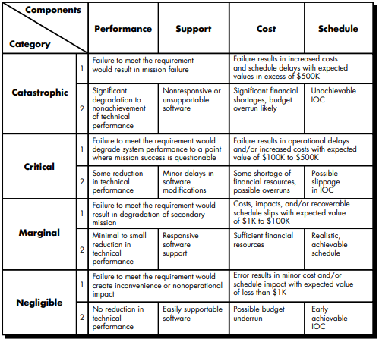
The impact of each risk driver on the risk component is divided into one of four impact categories—negligible, marginal, critical, or catastrophic.

Slide 9
RISK PROJECTION
Risk projection, also called risk estimation. The project planner, along with other managers and technical staff, performs four risk projection activities:
Set a Likelihood Scale: Create a way to rate how likely a risk is, like "low," "medium," or "high.“
Describe Consequences: Clearly explain what could go wrong if the risk becomes a reality.
Estimate Impact: Predict how bad the effect will be on the project and the final product.
Check Accuracy: Be clear about how reliable the estimates are. if your guesses about the risks aren't accurate, it could lead to misunderstandings or poor planning.

Slide 10
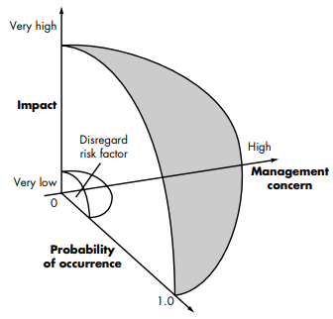
1.Probability of Occurrence (x-axis):
It shows how likely the risk is to happen, ranging from "Very Low" (near 0) to "Very High" (close to 1.0).
2.Impact (y-axis):
It shows how severe the consequences of the risk would be if it occurred, ranging from "Very Low" (bottom) to "Very High" (top).
3.Management Concern (shaded area):
The shaded region indicates which risks should be given attention by the management.
Risks with high probability and high impact (top-right corner) are the most concerning and need immediate action.
4.Disregard Risk Factor (unshaded area):
The small area in the bottom-left corner represents risks with low probability and low impact. These risks can usually be ignored because they don’t pose a significant threat to the project.

Slide 11
Assessing Risk Impact
Assessing risk impact involves understanding how a risk could affect the project if it happens. Three key factors are considered:
1.Nature of the Risk:
This explains what kind of problems the risk might cause.
So, knowing the "nature" helps identify specific areas where problems might arise.
2.Scope of the Risk:
This measures:
How severe the problem is (how serious?).
How wide-reaching it is (how many parts of the project or how many customers will be affected?).
3.Timing of the Risk:
This looks at when and how long the risk will affect the project.
Timing helps managers plan when to deal with the risk.

Slide 12
RISK REFINEMENT
Given that all reusable software components must conform to specific design standards and that some do not conform, it may result in only 70% of reusable components being usable, while the remaining 30% would need to be custom-built, increasing effort and cost.
This general condition can be refined in the following manner:
1.Third-Party Components (Subcondition 1):
Some reusable components were created by external vendors who had no knowledge of the project's internal design standards.
Why it’s a risk: These components might not integrate well or meet the project's technical requirements.
2.Unfinalized Design Standards (Subcondition 2):
The interface design standards (rules for how components communicate) haven’t been finalized yet.
Why it’s a risk: If the standards change, some existing reusable components may no longer fit or work correctly with the system.
3.Unsupported Programming Languages (Subcondition 3):
Some reusable components were written in a programming language that the target system cannot support.
Why it’s a risk: These components would need to be rewritten or replaced, increasing development time and cost.

Slide 13
Risk Mitigation, Monitoring, and Management (RMMM)
1. Risk Mitigation (Reducing Risks)
What it means: Taking steps to reduce the chances of a risk happening or lessen its impact if it does happen.
How it works:
Identify the risk and its cause.
Plan actions to avoid or reduce the risk.
2. Risk Monitoring (Keeping an Eye on Risks)
What it means: Constantly checking if the risks are becoming real or if any new risks are emerging.
How it works:
Use tools like checklists, progress reports, or meetings to track risks.
Watch for warning signs, such as missed deadlines or budget overruns.
3. Risk Management (Dealing with Risks)
What it means: Handling risks that occur by following a plan to minimize their damage.
How it works:
Respond quickly to reduce the impact.

Slide 14
SAFETY RISKS AND HAZARDS
Risk is not limited to the software project itself. Risks can occur after the software has been successfully developed and delivered to the customer. especially when it is part of safety-critical systems like nuclear reactors, aircraft, or industrial control systems.
Post-Delivery Risks:
Even if software works well when developed, it can still fail in the real world after delivery.
These failures can cause huge financial losses or, in critical systems, harm people or the environment.
Safety-Critical Systems:
In the past, people were hesitant to trust computers and software to control life-critical processes like nuclear plants or airplanes.
The main concern was that even a small hidden fault could lead to catastrophic outcomes, like accidents or system failures.
Why Software is Still Used:
Despite the risks, using software for control systems is now common because:
It offers huge cost savings.
It provides better functionality and efficiency than traditional hardware-based systems.
The Challenge with Software:
Software adds complexity to systems, making them harder to analyze for hidden faults compared to hardware.
2. Design errors caused by humans can be subtle and difficult to detect during development

Slide 15
Software Safety & Hazard Analysis :
These are processes that focus on identifying potential hazards early in the software design phase.
If hazards are found, the software can be designed to eliminate or control them before development starts.

